Slide 2
Call Me Friend
A Practical Guide to Buddy Ministry

Slide 3
Luke 14:21, 23
“…Go quickly into the streets and alleys of the town, and invite the poor, the crippled, the blind and the lame…and urge anyone you find to come so that the house will be full.”

Slide 4
What is an Irresistible Church?
“An Irresistible Church is an authentic community built on the hope of Christ that compels people affected by disability to fully belong.”

Slide 5
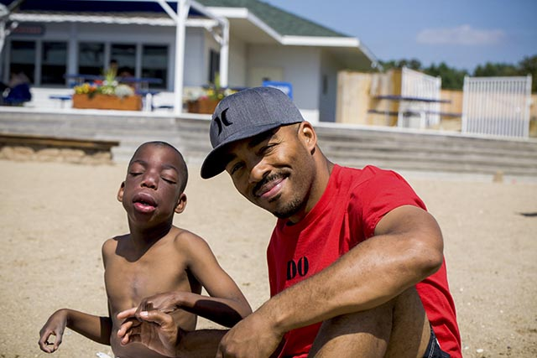
Agenda
Definitions
What Buddies Provide
Behind the Scenes
On the Front Lines: The Details

Slide 6
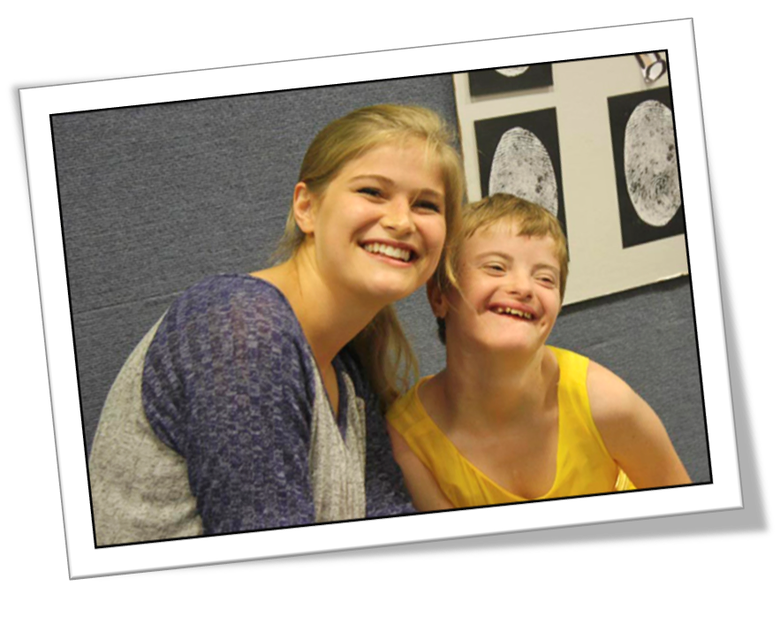
What is a Buddy Ministry?
A Buddy Ministry is a program of the church designed to support the disability community by pairing an individual with a disability with a buddy during church services so that they can participate within the mainstream programs of the local church.

Slide 7
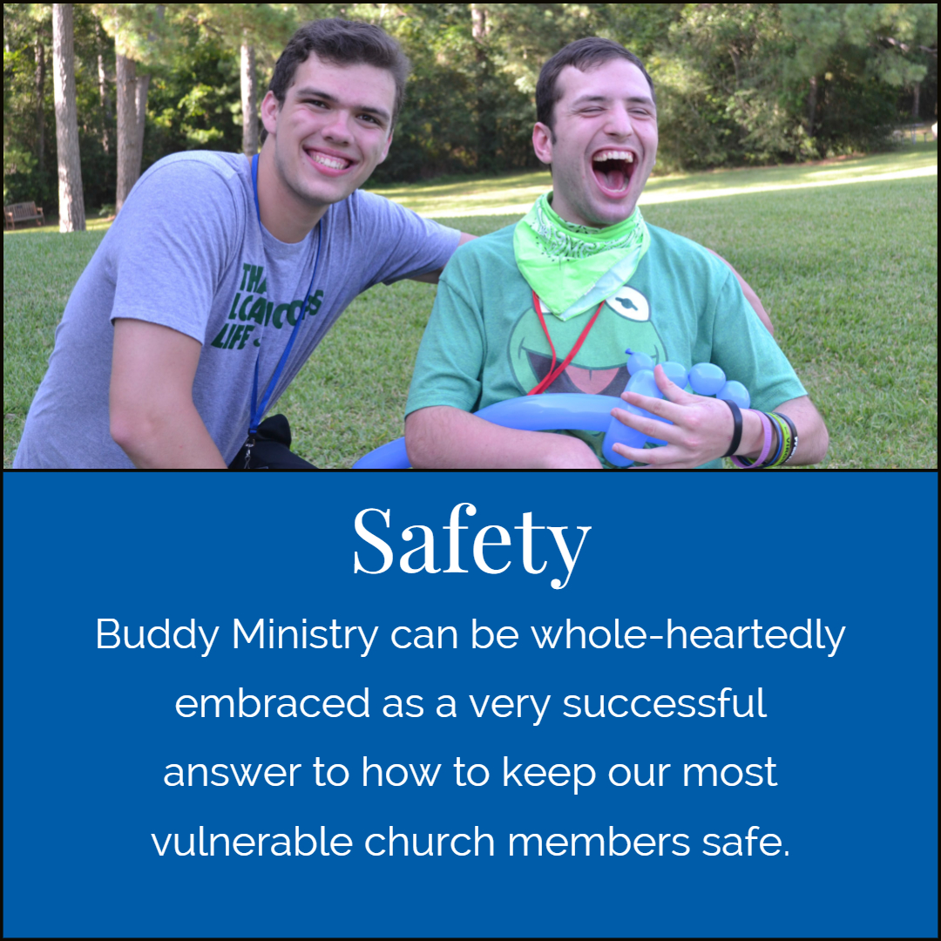
What Buddies Provide

Slide 8
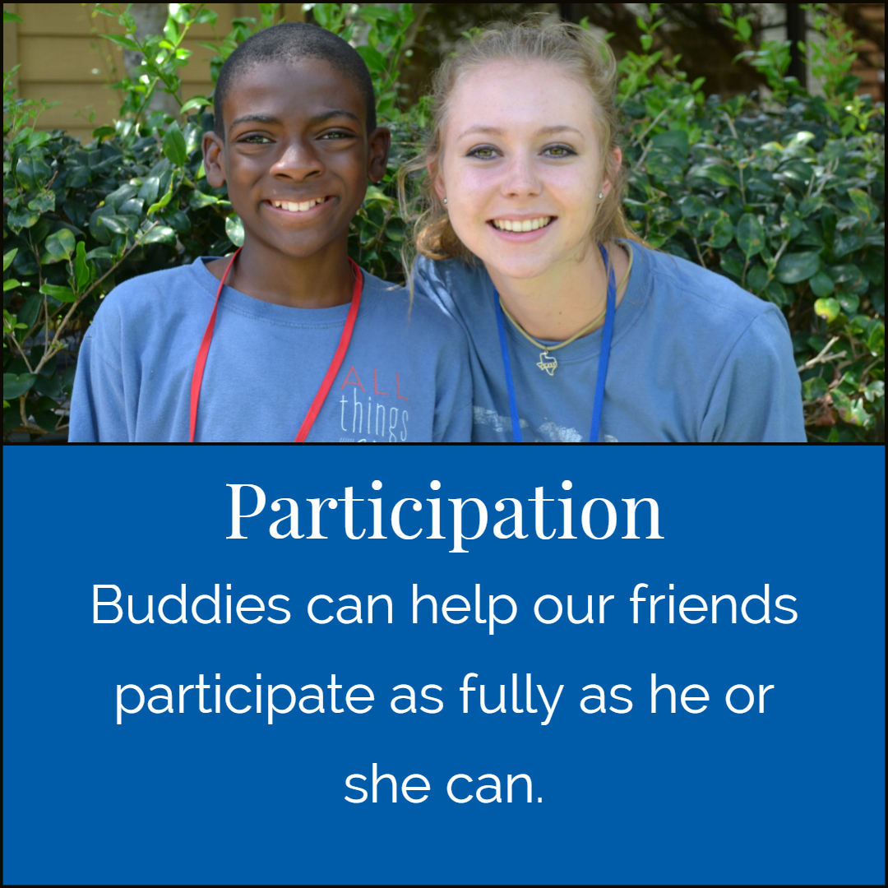
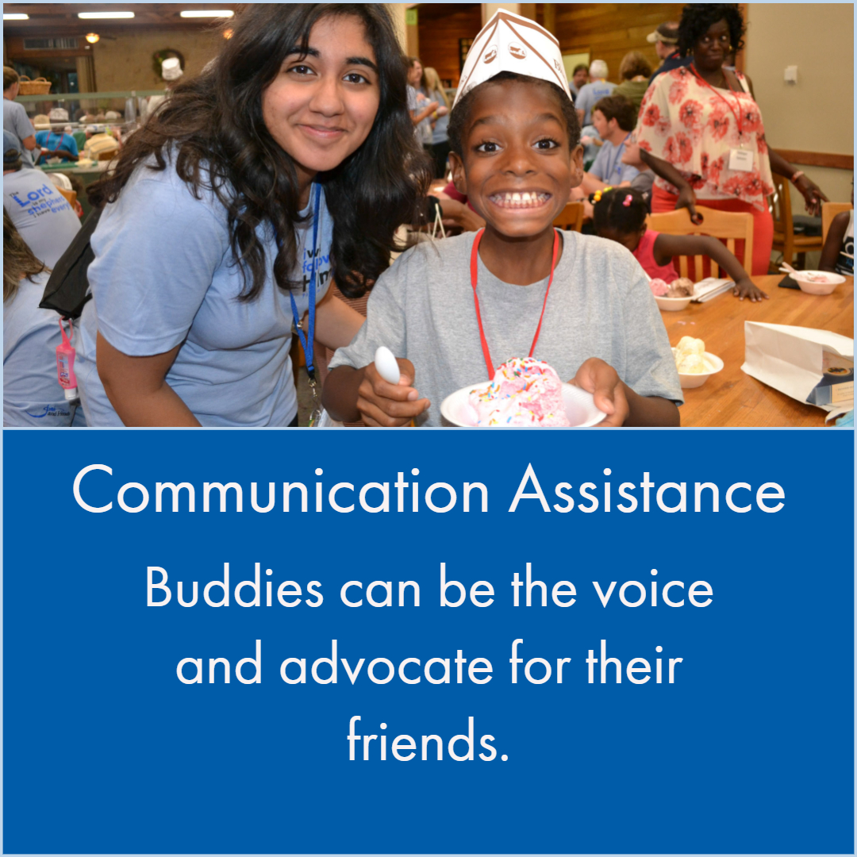
What Buddies Provide

Slide 9
Activity: What Buddies Provide
Who can be a buddy?

Slide 10
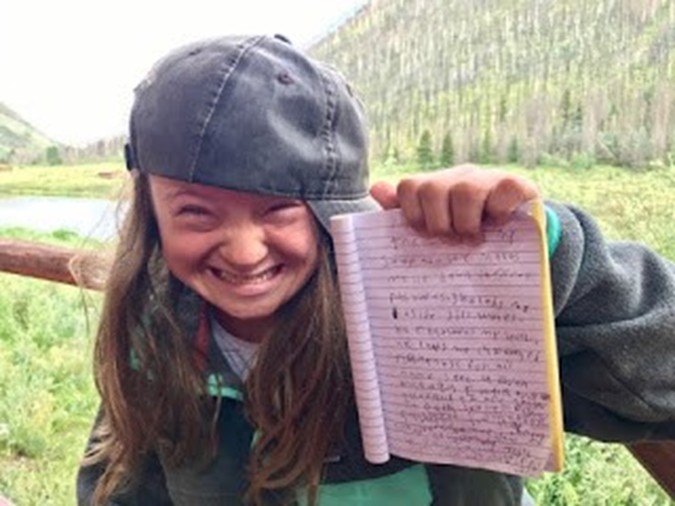
Behind the Scenes
Ministry Leadership
Documentation and Debrief

Slide 11
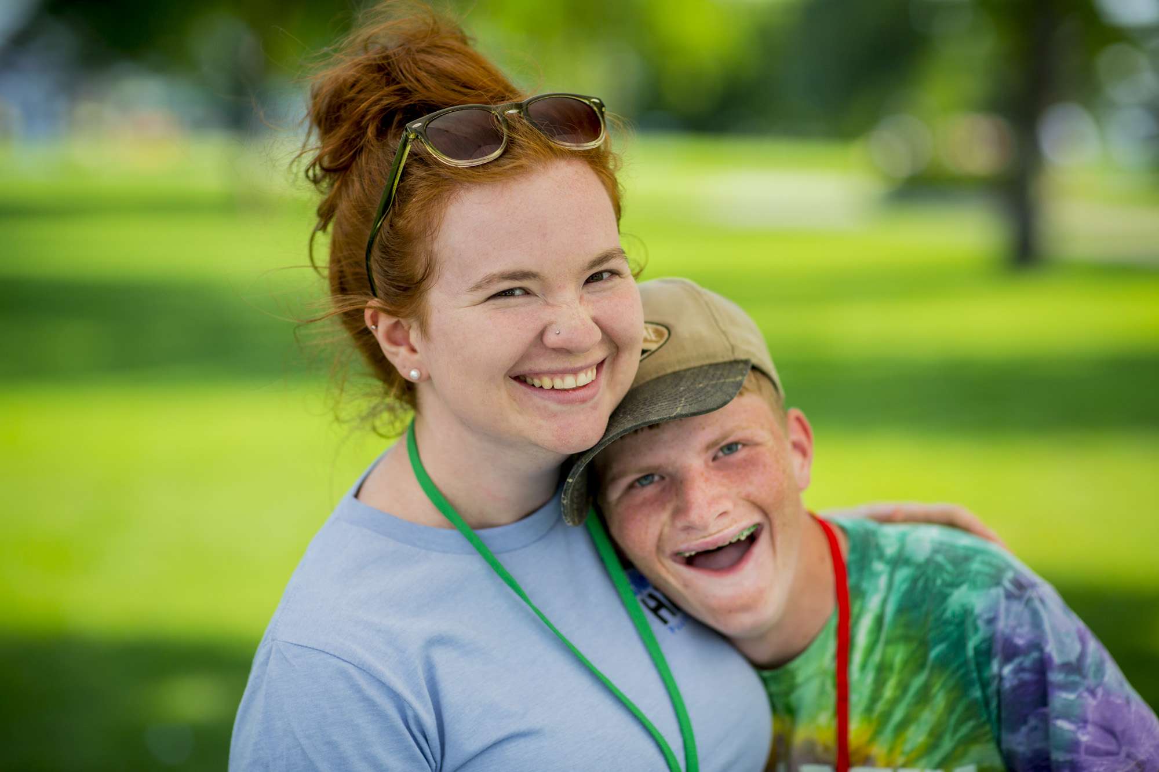
On the Front Lines: The First Steps to Getting Buddies
Terms of Service
Recruiting Buddies
Training Buddies

Slide 12
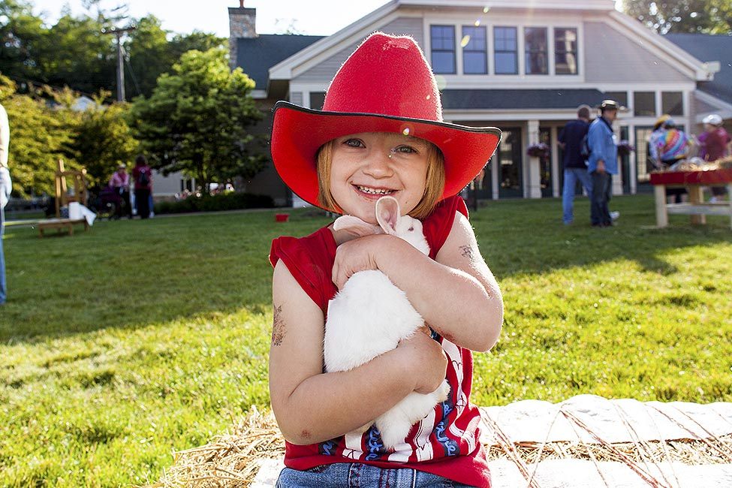
Lisa’s Story

Slide 13
The Details
Pairing Buddies with Friends
When a Diagnosis is Suspected
Family Vounteers
Scheduling
Buddy Support

Slide 14
https://irresistiblechurch.org/library/
Supplemental Resources available include: Accessibility Checklist, Church Survey, Disability
Etiquette, Disability Training stations, Family Ministry Profile, Recommended Resources, Volunteer
Job Description, Volunteer Training topics.

Slide 15
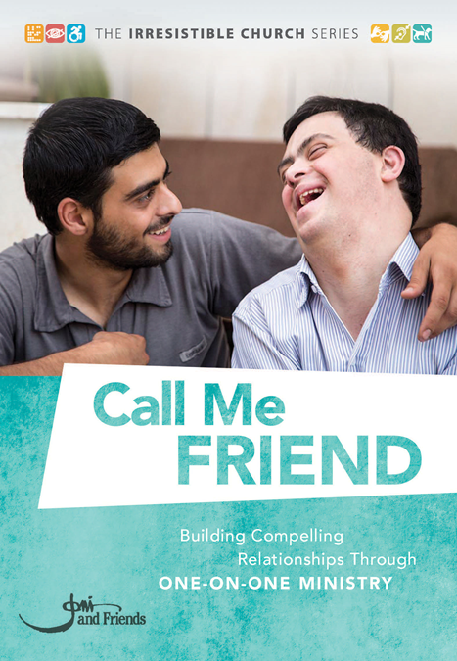
Questions
Please feel free to contact me
Jane Doe
555-123-4567
JaneDoe@email.com

