Slide 1

SESSIONs 1-4
Introduction for Christian Leaders

Slide 2
SESSION ONE
Theology of
Suffering and Disability

Slide 3
  Luke’s Concentration on the Kingdom of God
  The Luke 14 Mandate: A Closer Look
  Hosting a Luke 14 Banquet

Slide 4
Luke’s Concentration on the Kingdom of God
Luke opens the lens through which
we come to understand God’s compassion
toward the outcast and sinners.

Slide 5
Messianic Prophecies Found in Luke and Acts
32 References to Messianic Prophecies
showing Christ’s ministry to:
              The Gentiles
              The Broken
              The Outcast

Slide 6
Major Themes in the Gospel of Luke
Overarching Theme:
Jesus Is Savior of All!
Regardless of ethnicity, gender, socioeconomic status.

Slide 7
Secondary Themes:
salvation for all – prayer – Christianity’s history stewardship – women in Christ’s ministry

Slide 8
The Luke 14 Mandate
“But when you give a banquet, invite the poor, the
crippled, the lame, the blind… Go out to the roads
and country lanes and make them come in,
so my house will be full.”
Luke 14:13, 23b

Slide 9
“The Lost Great Commission”
It is the kingdom’s door swung open for all – the strong and the weak, the rich and the poor, the healthy and the sick, and people with or without disabilities.

Slide 10
The Contrasts and Reversals of the Kingdom
Luke 14:7-24

Slide 11
Who Is the Greatest in the Kingdom?
Luke 14:7-11
“For everyone who exalts himself will be humbled
and he who humbles himself will be exalted.”
Luke 14:11

Slide 12
What Is the Nature of the Kingdom?
Luke 14:12-14
“When you give a banquet, invite the poor, the crippled, the lame and the blind.”
Luke 14:13
We are to include people with disabilities both in our personal lives as well as in our faith communities!

Slide 13
The Law of Reciprocity - Luke 14:14
Not simply a ministry of benevolence—
People with disabilities repay
with their presence and lives.

Slide 14
The Great Banquet –
Who Fills the Seats at the Table?
Luke 14:15-24
The Jewish leaders’ expectations of the Kingdom of God
VS.
Jesus’ expectations of the Kingdom of God!
Both now and to come!

Slide 15
The Great Banquet – Consummation!
Isaiah 25:6-9
    Incorrect and false scriptural interpretations by Jews
    Jesus properly interpreting the original message of Isaiah 25

Slide 16
Jesus redefines the Great Banquet and the nature of the kingdom!
The Host of hosts determines the final guest list…and the seats of honor – not who the Pharisees expected.
His house will be filled with these disabled guests!
It is an urgent and compelling mandate!

Slide 17
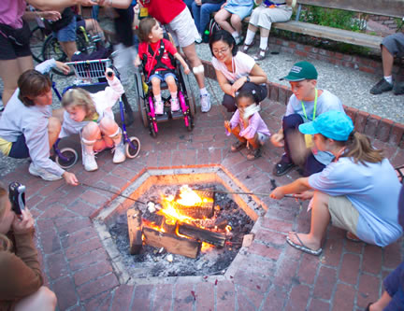
Hosting a Luke 14 Banquet
Outreach to disability community
Build relationships between church volunteers and families

Slide 18
Are You Living a Kingdom Lifestyle?
If the kingdom is one in which those with disabilities
have a seat of honor, how can the Church honor
the King’s heart for the overlooked in society?
Courtesy l Hospitality l Radical Inclusion

Slide 20
SESSION TWO
The Church and
Disability Ministry

Slide 21
  Identifying the Church’s Theological Framework
  Where Is the Church Today?
  Practical Applications for the Church

Slide 22
Organism
Organization
When a church fails to welcome the disability community there’s a high price to pay.
I tell you the truth, whatever you did not do for one of the least of these, you did not do for me.
Matthew 25:45

Slide 23
Identifying the Church’s
Theological Framework
Ecclesiology: The Doctrine of the Church
We are a “Chosen People”
ekklesia meaning “out of”
kaleo meaning “to call”
kuriakon meaning “belonging to the Lord”

Slide 24
The Biblical Nature of the Church
      The People of God
      The Body of Christ
      The Temple of the Holy Spirit

Slide 25
The Biblical Functions of the Church
      Worship
      Instruction
      Edification
      Evangelism
      Organization
      Ordinances

Slide 26
Koinonia – The Ingredient for Community Life
communion l fellowship l shared community
In “doing” church we can often
forget to “be” the church.

Slide 27
Where Is the Church Today?
Why Are Many Churches Missing the Mark?
We prefer our members to wear the right clothes, drive the right cars, and know the right vernacular. But this is an illusion and a misunderstanding
of what God truly desires…
our brokenness.

Slide 28
The Church as a Broken Body
Christ is the ultimate example of identification.
Through relational ministry to and with broken people, God breaks, blesses and gives away transformed and selfless lives.

Slide 29
The Church as a Suffering Body
  Jesus, the Suffering Servant
  Paul’s Call to Suffering
  The Church’s Call to Suffering
God’s intention for his church is that we
embrace our own suffering, as well as
embrace those who suffer.

Slide 30
The Church as the Mature Body
  The privilege of ministry to the broken.
  The privilege of joining in the priesthood.
  The privilege of understanding our call to serve.

Slide 31
Practical Applications for the Church
It is the church that prayerfully seeks
God for a sensitive heart toward those
who are in need that finds opportunities
for the richest ministry.

Slide 32
Seven Movements of Ministry to
Persons with Disability
Ministry of Fellowship
(Program → Presence)
2. Ministry of the Word
(Quantitative → Qualitative)
3. Ministry of Obedience
(Convenience → Conviction)

Slide 33
4. Ministry of Identification
(Being Understood → Understanding)
5. Ministry of Prayer
(Being Important → Being Available)
6. Ministry of the Spirit
(Being Heard → Listening Intently)
Ministry of Reciprocity
(Teaching → Being Taught)

Slide 34
The Tale of Two Families
Discuss the Siebels family’s experience
  How does their story make you feel?
  What could have been different?
Discuss the Jaramillo family’s experience
  What key words in their testimony stood out to you?
  How was their experience different?

Slide 35
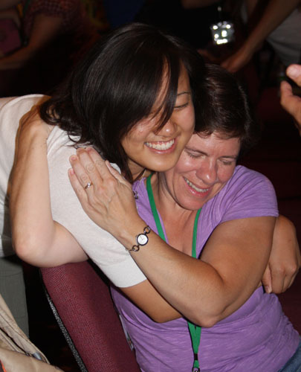
Which church would you want to belong to?
Which church demonstrated Koinonia?

Slide 36
Where Is Your Church Today?
If one part suffers, every part suffers with it; if one part is honored, every part rejoices with it.
1 Corinthians 12:26
Is Acts 2:42-47 being modeled in
your church’s Disability Ministry?

Slide 38
Session three
How to Start a Disability Ministry in the Church

Slide 39
  Addressing Concerns about Disability Ministry
  Everything Rises and Falls on Leadership
  Ten Practical Tips for Becoming a Disability Friendly Church
  Intentional Inclusion

Slide 40
The Goals of Disability Ministry
Opens the door to share the gospel with people with disabilities.
Integrates people with disabilities into the life of the church and gives them opportunities in serving God.
Enables the church to serve as a witness and model to the community for meeting spiritual, physical and social needs of those with disabilities.

Slide 41

Addressing Concerns about
Disability Ministry
God’s love and mercy
qualifies Christians to reach into their communities where
an estimated 20% of their neighborhoods are affected
in some way by disability.

Slide 42
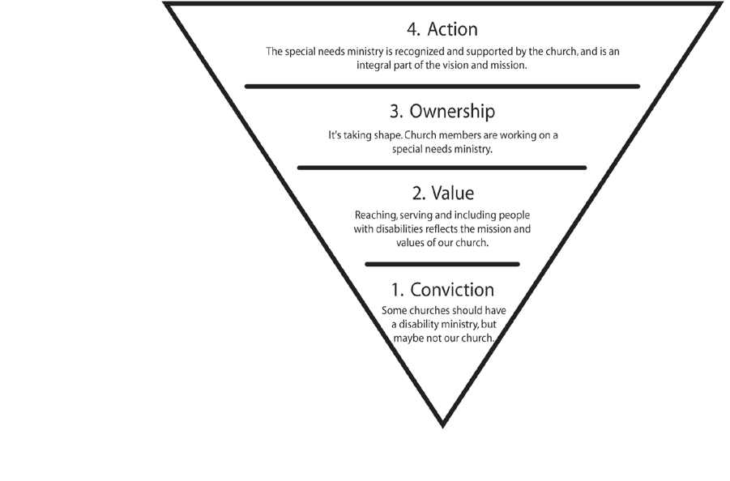
Moving from Conviction to Action

Slide 43
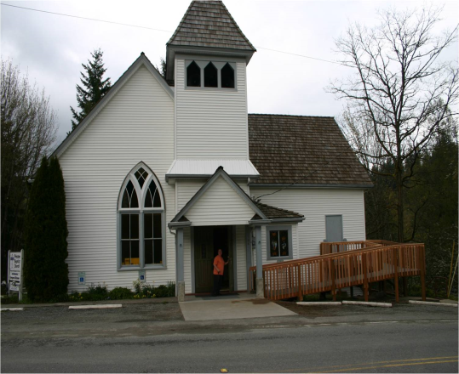
Barriers to Participation
Architectural
Attitudinal
Theological
Communication
Pragmatic
Liturgical
“Ministry is messy. God plops people with disabilities in the midst of a congregation—a hand grenade that blows apart the picture-perfectness of the church. But these disenfranchised folks are the ‘indispensable’ part of the body.” ~Joni Eareckson Tada

Slide 44
Everything Rises and
Falls on Leadership
No “Lone Rangers” in Ministry
You Need Not Look Far to Find People with Disabilities
C. What Will Disability Ministry Cost?
D. Many Are Called But Few Are Chosen

Slide 45
Ten Practical Tips for Becoming a
Disability-Friendly Church
Welcoming Environment
Disability Awareness Training
Improve Accessibility
Opportunities to Serve
Disability-Friendly Materials

Slide 46
Ten Practical Tips, Cont.
Space for Wheelchair Users
Sign Interpreter
Communication & Interaction Tips
Parking Assistance
Buddies/Mentors Available

Slide 47
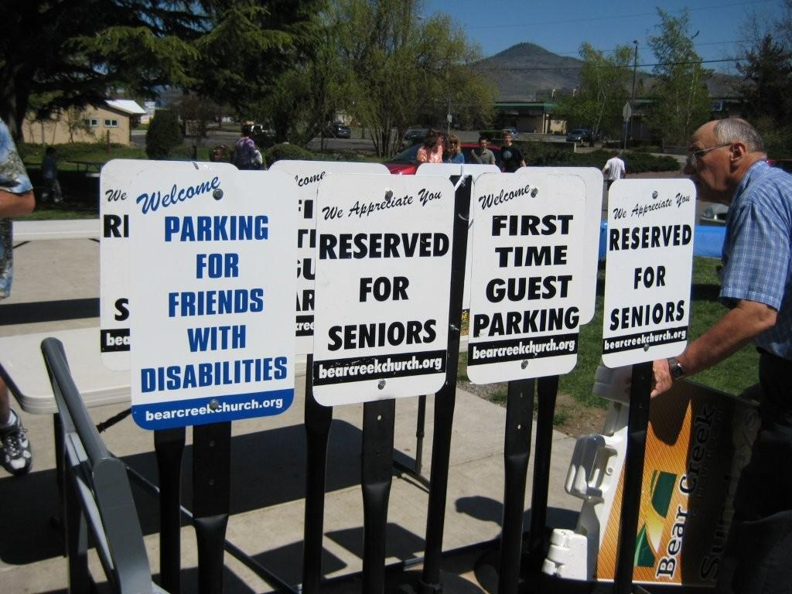
Intentional Inclusion

Slide 48
“We don’t have a special needs ministry to grow
numbers. We do it because it’s the biblical mandate of the church of Jesus Christ.”
—Pastor Spoor

Slide 49
Are you ready to create an
Action Plan?
With God all things are possible.
Matthew 19:26

Slide 51
SESSION four
Outreach and Evangelism to Families Affected by Disability

Slide 52
  God, Open Our Eyes to People Without Christ
  God, Open Our Mouths to Speak the Gospel
  God, Show Us How to Live What We Proclaim
  God, Help Us Show the Gospel in Word and Deed
  God, Open Our Lives to Outreach and Discipleship

Slide 53
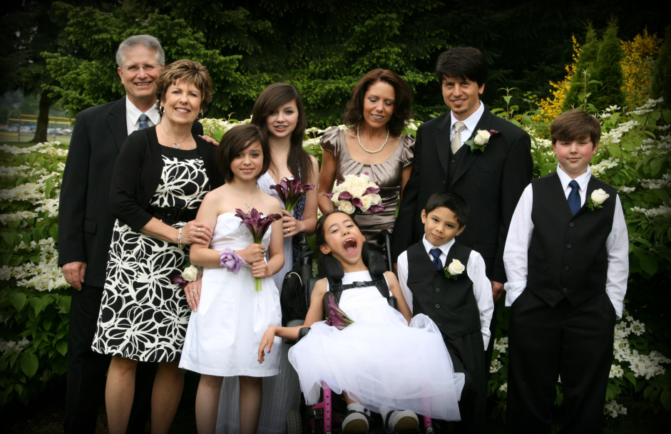
When you reach out to one person affected by disability, you are also reaching out to the many people involved in his or her life.

Slide 54
God, Open Our Eyes to
People Without Christ
Scripture Illuminates Our Mission
      The “Mission Statement”—Luke 4:18-21
      The Great Commission—Matthew 28:18-20
      The Luke 14 Mandate—Luke 14:21-23

Slide 55
Acceptance Shines Light in Our Hearts
If we judge the faith of our friends with disabilities by a faulty understanding of what faith actually is, we see them as “incapable” of becoming Christians who can share their faith with us.

Slide 56
God, Open Our Mouths to
Speak the Gospel
Salvation Is Based upon Proper Beliefs
        Who is Jesus Christ?
            Jesus Christ is fully God and fully man.
        Who is God?
        He is a Person and the Trinity.

Slide 57
        Who is Man?
            Created by God
Man was the pinnacle of God’s creation, designed to think and act like God yet not an equal of God.
            Fallen by Choice
            Man cannot save himself through his own effort.

Slide 58
What Is Salvation?
Jesus said to him, “I am the way, and the truth, and the life, no one comes to the Father but through me.”
John 14:6, NASB
If you confess with your mouth Jesus as Lord, and believe in your heart that God raised him from the dead, you shall be saved; for with the heart man believes, resulting in righteousness, and with the mouth he confesses, resulting in salvation.
Romans 10:9-10, NASB

Slide 59
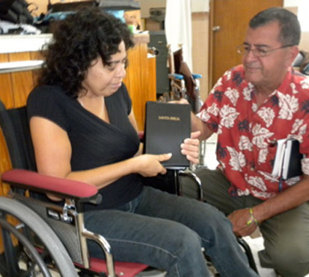
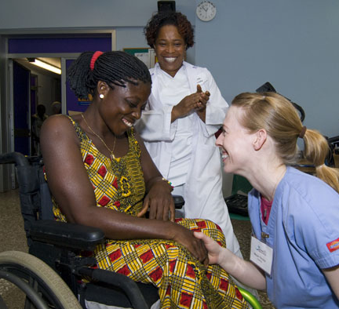
God, Show Us How to
Live What We Proclaim
There are two primary ways to proclaim the Gospel:
Word & Deed

Slide 60
Word: Hearing and Reading
Proclamation in word without deed leads to an irrelevant Gospel.
“He was a prophet, powerful in word and deed before God and all the people.”
Luke 24:19

Slide 61
Deed: Seeing and Experiencing
Proclamation in deed without word results in a powerless Gospel.
You know…how God anointed Jesus of Nazareth with the Holy Spirit and power, and how he went around doing good and healing all who were under the power of the devil, because God was with him.
Acts 10:37-38

Slide 62
Joining the Kingdom Work
At church we are equipped to go out into the world
to make Christ real and reclaim territory from the devil
under the banner of Christ.

Slide 63
God, Help Us Share the Gospel in Word and Deed
Principles in Adapting the Message for our Friends with Disabilities:
        Friends with Intellectual Disabilities
The majority of people with mental disabilities
can understand Scripture on a third-grade level.
—Dr. Jim Pierson

Slide 64
        Friends with Developmental Disabilities
Relational evangelism happens when we “hang out” with these friends and “do life” together.
        Friends with Hearing or Visual Impairments
Use a simple explanation of the plan of salvation, making use of resources like Braille Bibles and sign language interpreters.

Slide 65
        Friends Who Are Nonverbal
Just because a person is nonverbal does not mean that he or she is incapable of communicating.
        Friends with Physical Impairments
Never assume that a person with a physical impairment either can or cannot participate in a given activity.

Slide 66
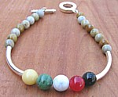

Evangelism Tools:
        Romans Road
        Wordless Book
        Gospel Bracelets
        The Four Spiritual Laws
        Created in the Image of God

Slide 67
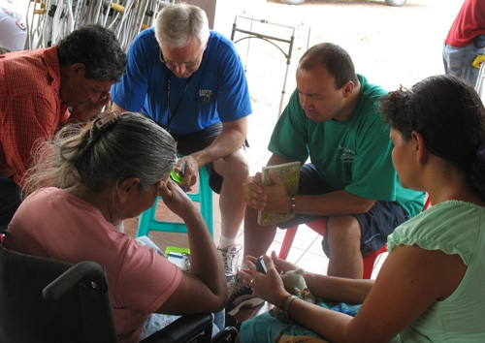
God, Open Our Lives to
Outreach and Discipleship
Family Support Groups

Slide 68
“When in the world, we live as Christ would
have us live, it prompts the question of
‘What must I do to be saved like you?’”
—Joni Eareckson Tada

