Slide 2
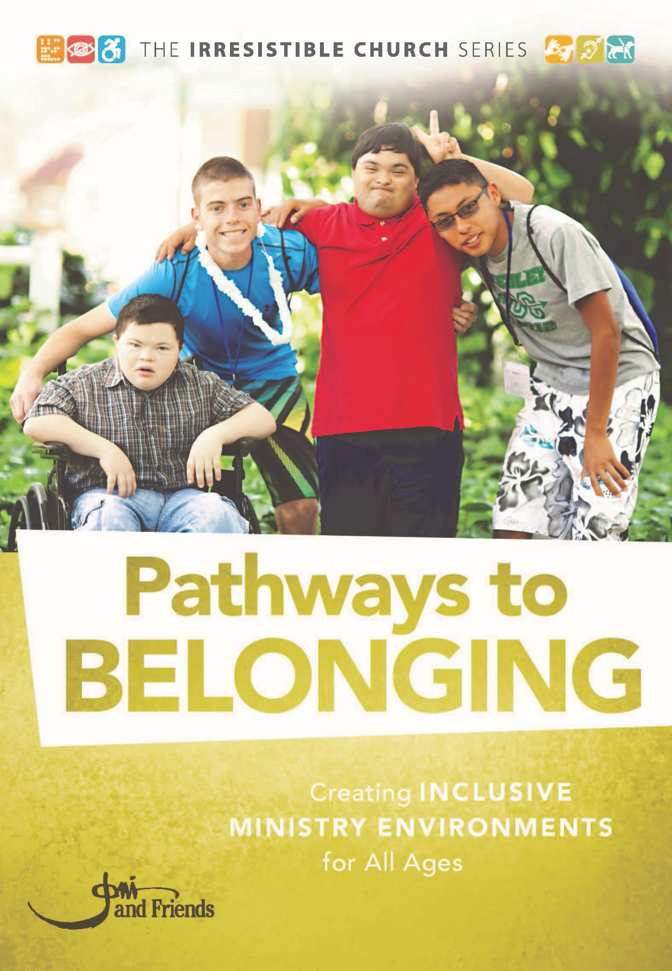
Irresistible Church
“An Irresistible Church is an authentic community built on the hope of Christ that compels people affected by disability to fully belong.”

Slide 3
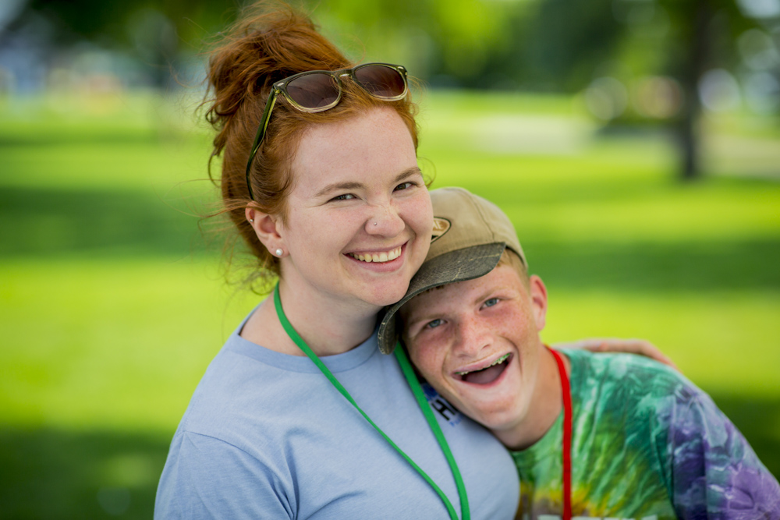
Pathways to BELONGING
“To belong is to be missed when you are absent.”
-John Swinton

Slide 4
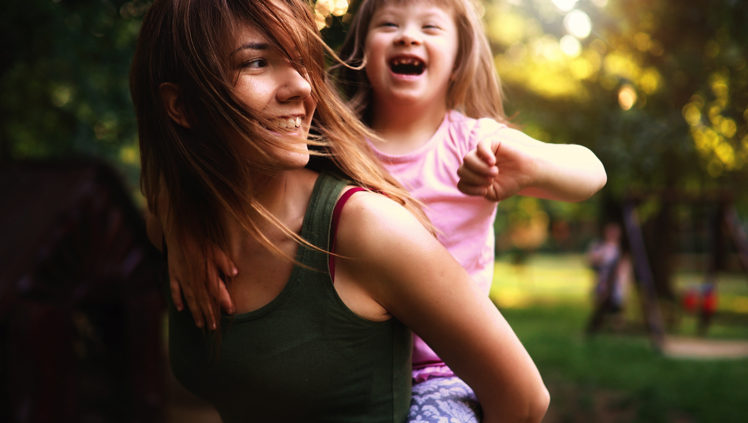
What Does it Look Like to Fully Belong?
Full Access to…
Fellowship
Worship
God’s Word

Slide 5
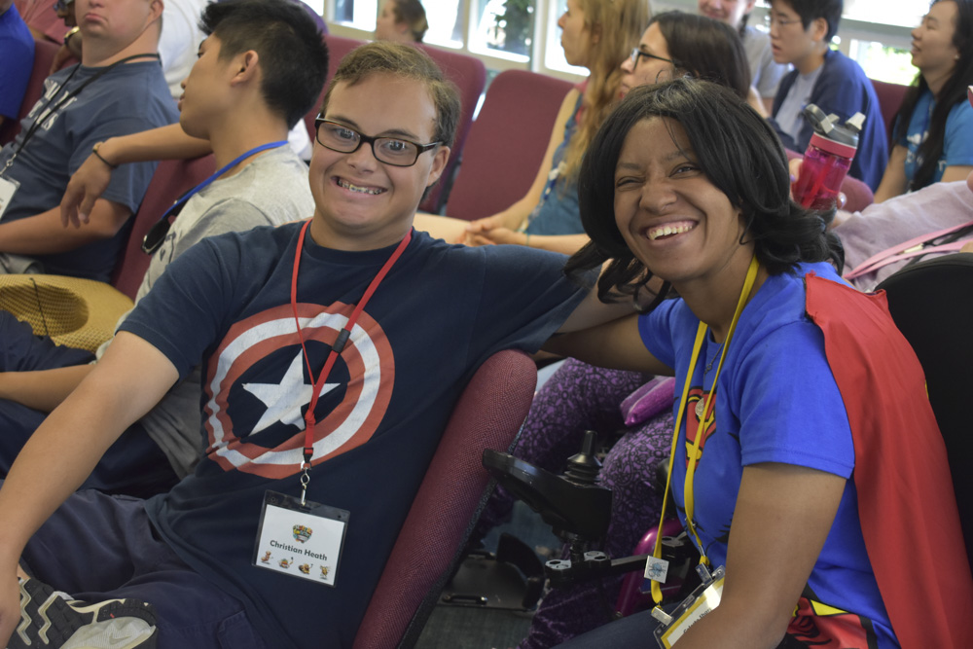
Three Ministry Models
Inclusive
Teaching
Specialized
Teaching
Fully
Inclusive
Hybrid
Inclusive
Worship
Hybrid
Self-contained
classroom
Specialized
Worship

Slide 6
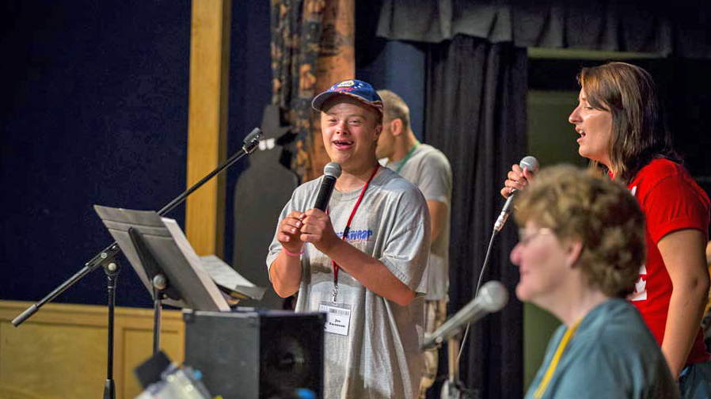
John 14:25-26
“All this I have spoken while still with you. But the Advocate, the Holy Spirit, whom the Father will send in my name, will teach you all things and will remind you of everything I have said to you.”

Slide 7
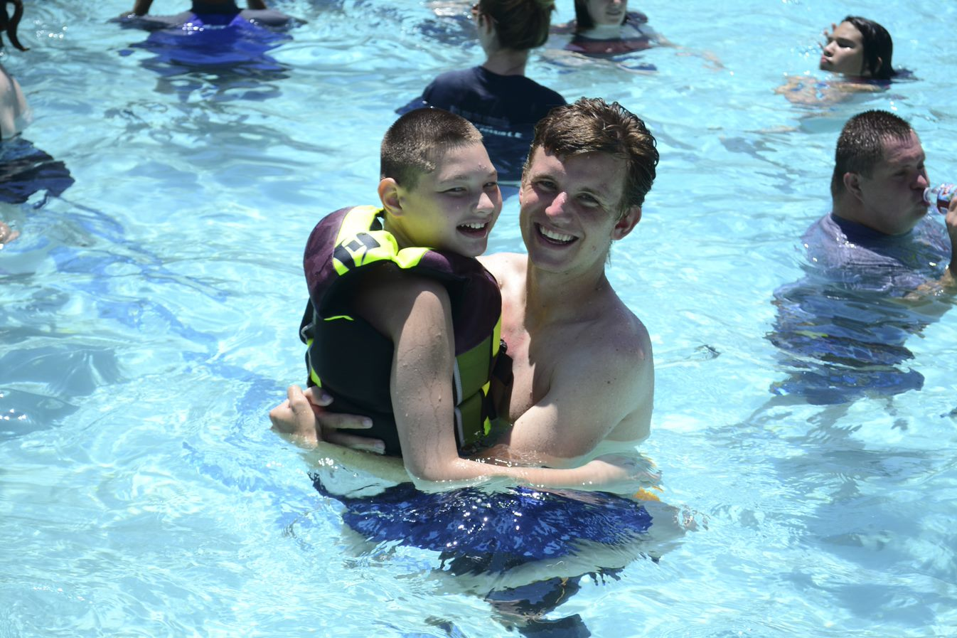
Buddy Ministry
Most inclusive option
Fewest resources required
Provides:
Discipleship
Friendship
Safety

Slide 8
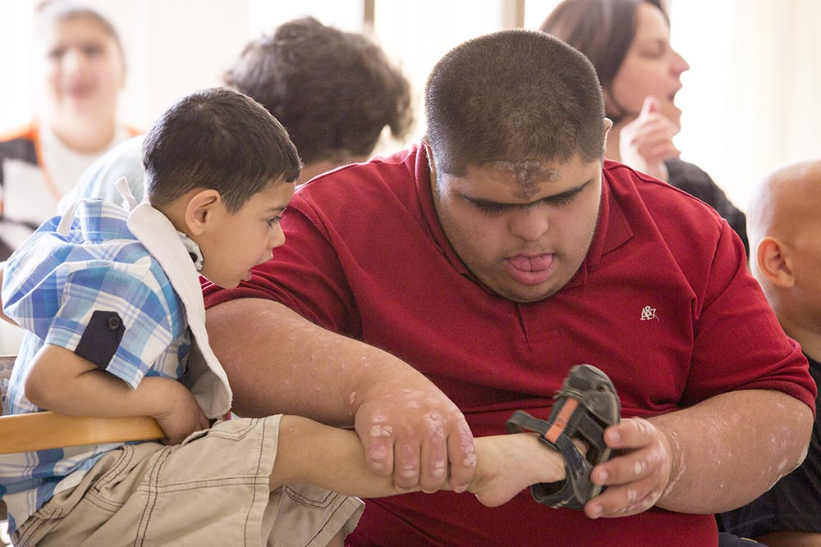
The 5 Environments
Physical environment
Sensory environment
Social environment
Communication environment
Cognitive environment

Slide 9
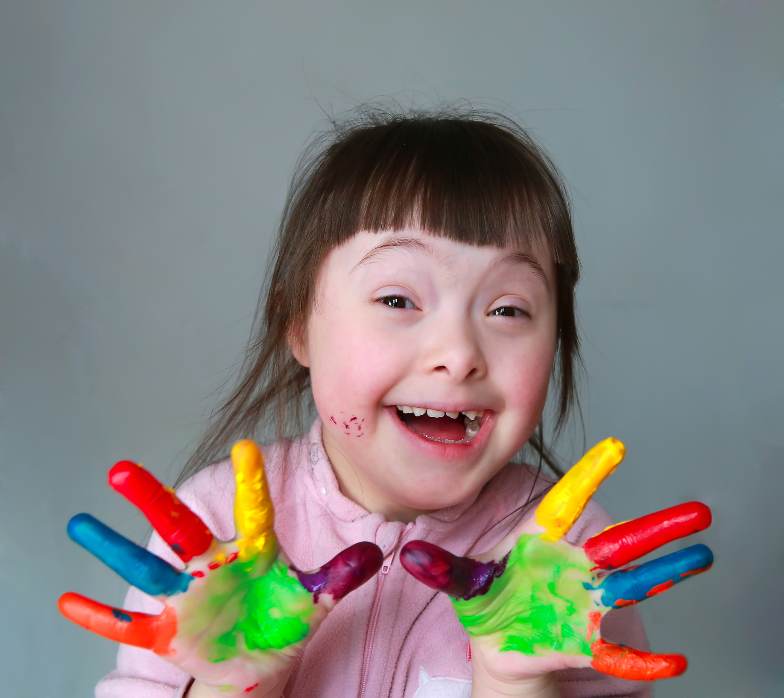
When do you Need a Hybrid Ministry?
Not thriving in a 1-on-1 buddy environment
Sensory overload is occurring
There are too many changes and transitions
Aggression towards self or others

Slide 10
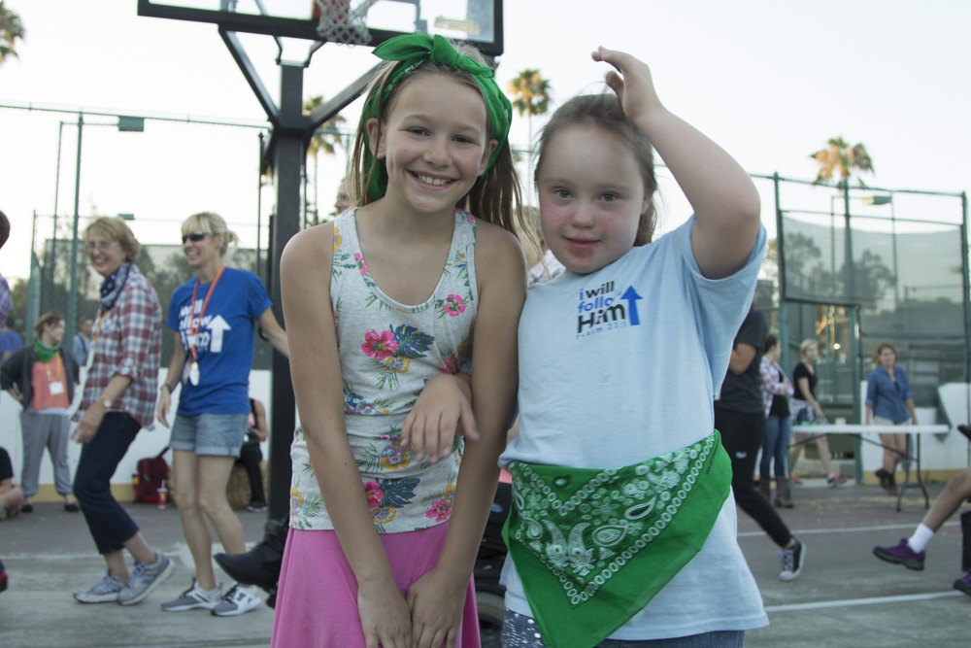
What can a Hybrid Ministry Provide?
Participation in certain mainstream activities
Provides a season of evaluation
A bridge to mainstream activities as they mature

Slide 11
Moment of Reflection
Take a few moments to think about these questions…
Which parts of our current ministry model are creating the most friction for our friends with special needs?
Can the schedule be altered in minor ways to help ease this tension?

Slide 12
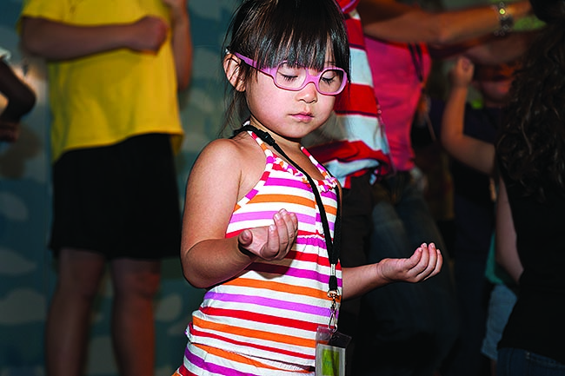
Positives of a Self-Contained Classroom
Personalized
Enables each person to learn in their unique style
Self-stimulating behavior, repetition, movement
First-time visitors
Consistency

Slide 13
Designing a Self-Contained Classroom
The Five S’s:
Space
Sensory stimulation
Set-up
Schedule
Safety

Slide 14
A Few Ideas for Lessons
Involve all their senses
Repetition, repetition, repetition
Involve movements
Act it out
Ask review questions
Individualize
Flexibility

Slide 15
Group Discussion
What are some ways you are already adapting curriculum?
What are ways you can further adapt your curriculum to meet the needs of a broader audience?

Slide 16
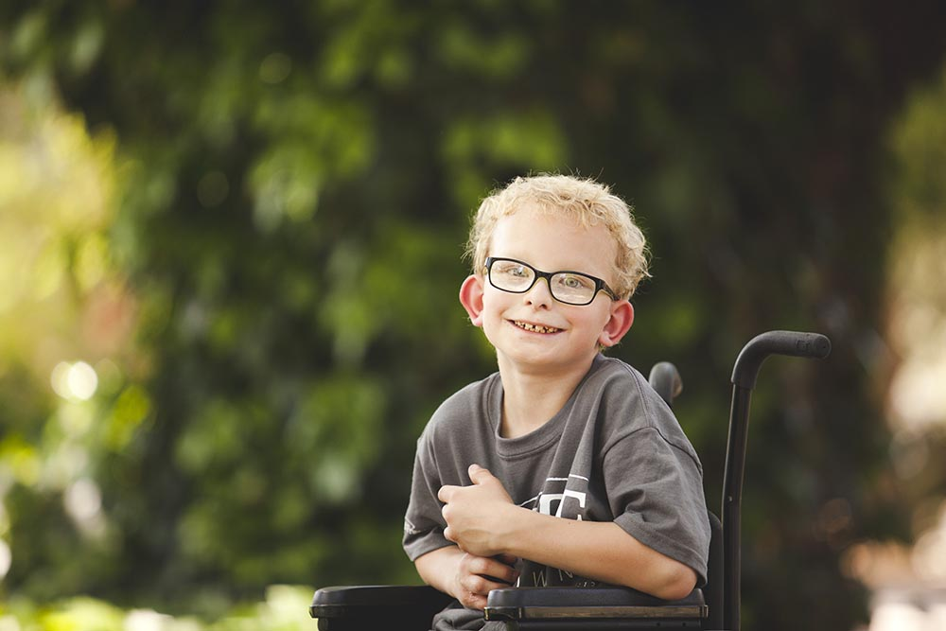
Children
Concrete
Engaging
Consistent

Slide 17
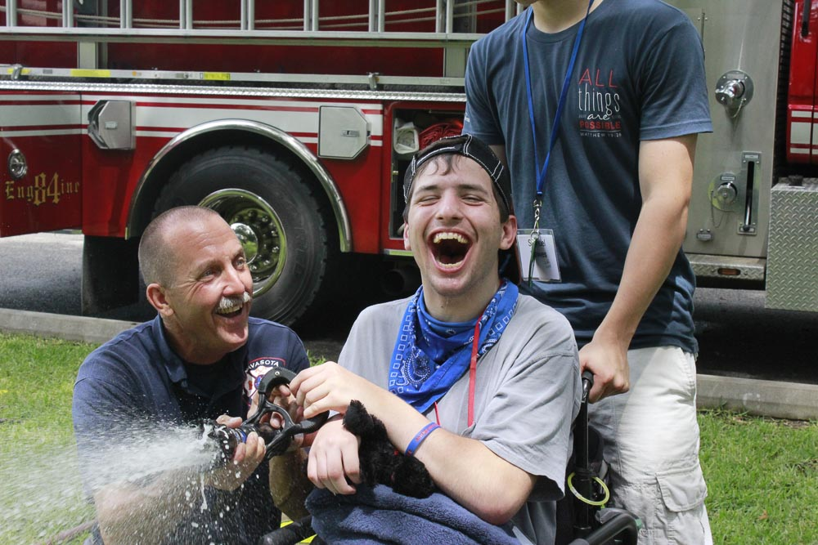
Teens
Build relationships with other teens
Plan in advance for social outings
Being a teenager is hard

Slide 18
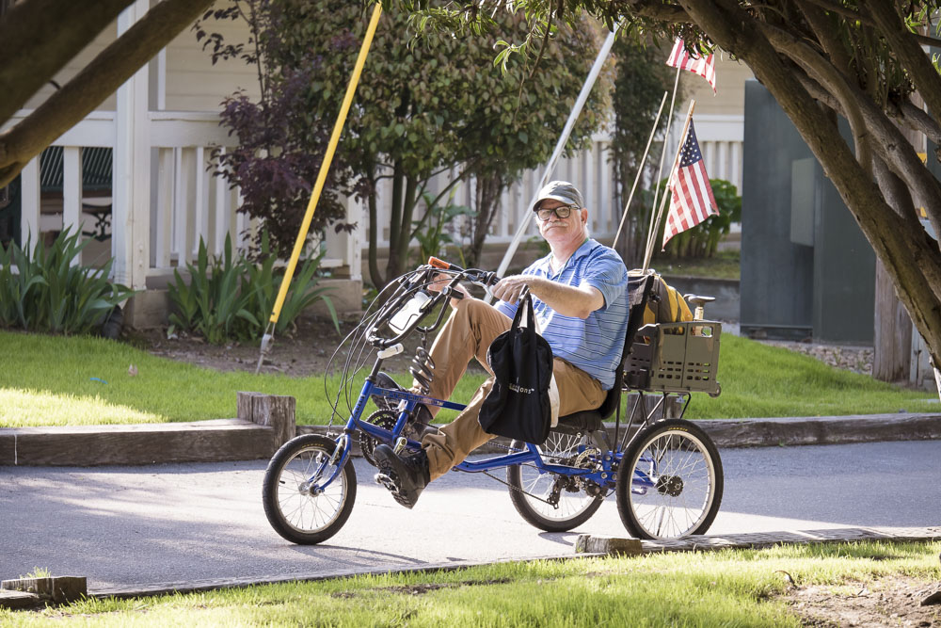
Adults
Fellowship

Slide 19
Mark 2:1-5
“And when (Jesus) returned to Capernaum after some days, it was reported that he was at home. And many were gathered together, so that there was no more room, not even at the door. And he was preaching the word to them.
And they came, bringing to him a paralytic carried by four men. And when they could not get near him because of the crowd, they removed the roof above him, and when they had made an opening, they let down the bed on which the paralytic lay. And when Jesus saw their faith, he said to the paralytic, “Son, your sins are forgiven.”

Slide 20
Adults
Fellowship
Service

Slide 21
1 Corinthians 12:12-14, 12:21-22
“For just as the body is one and has many members, and all the members of the body, though many, are one body, so it is with Christ.
For in one Spirit we were all baptized into one body—Jews or Greeks, slaves or free—and all were made to drink of one Spirit. For the body does not consist of one member but of many.
…
The eye cannot say to the hand, “I have no need of you,” nor again the head to the feet, “I have no need of you.” On the contrary, the parts of the body that seem to be weaker are indispensable…”

Slide 22
irresistiblechurch.org
Supplemental Resources available include: Accessibility Checklist, Church Survey, Disability
Etiquette, Disability Training stations, Family Ministry Profile, Recommended Resources, Volunteer
Job Description, Volunteer Training topics.

Slide 23
Questions
Please feel free to contact me
Jane Doe
555-123-4567
JaneDoe@email.com

